Slide 1
4. Measuring performance and preventing failure
(7.5 hours)

Slide 2
Summary
4.1 How to measure performance (2.5 hours)
4.2 How to avoid failure (2.5 hours)
4.3 Reconciling Waterfall and Agile (2.5 hours)

Slide 3
4.1 How to measure performance (2.5 hours)

Slide 4
Velocity: the key metric
Velocity: measure of the amount of work a team manages to complete during a single cycle/sprint.
It is calculated for each cycle, summing up the effort (in hours or points) expended to complete the 'done' cards.

Slide 5
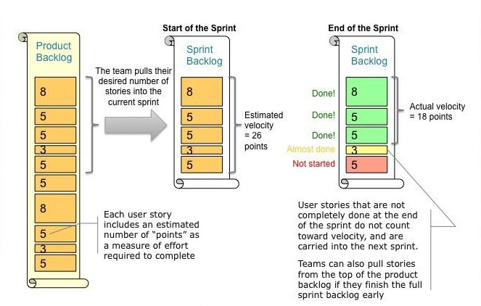
Velocity: the key metric

Slide 6
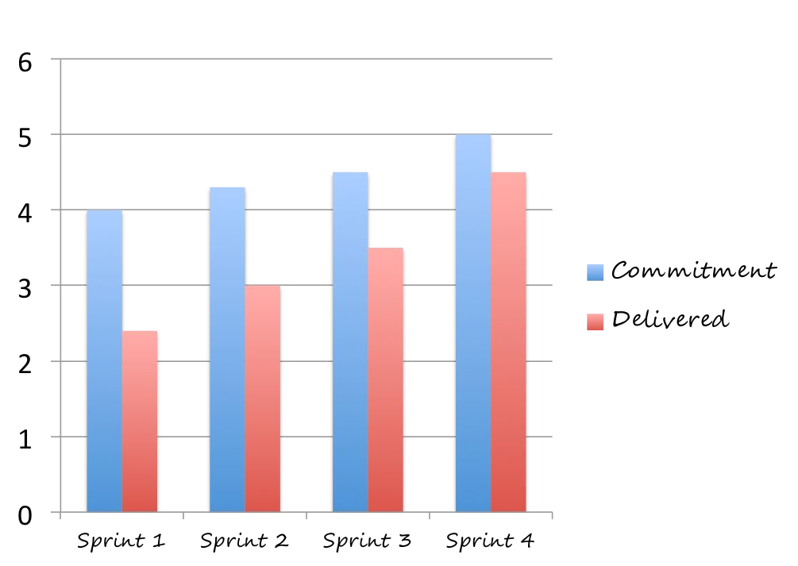
Velocity chart
Shows workﬂow speed and team workload per sprint.
Allows you to do forecasts for the future.

Slide 7
Velocity chart
Requirements:
Definition of work units (effort) for each task and duration of sprints.
Continuous communication between team members on completed/to-be-completed tasks.
At the end of each sprint, analysis of the number of completed work units.
Note: An actual velocity lower than the estimated one may denote:
FF too high
Optimistic estimates
Tip: to increase team velocity, start the retrospective from the 'blocked' cards.

Slide 8
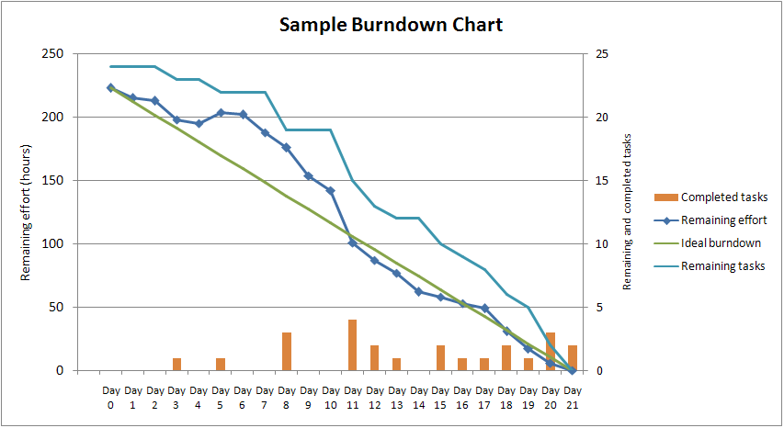
Burndown chart
Graphical representation of the work required to complete a project.
Usually the remaining work (or backlog) is indicated on the vertical axis and the time on the horizontal axis.
The diagram represents a time series of tasks to be completed.
It is useful for predicting when the work will be completed.

Slide 9
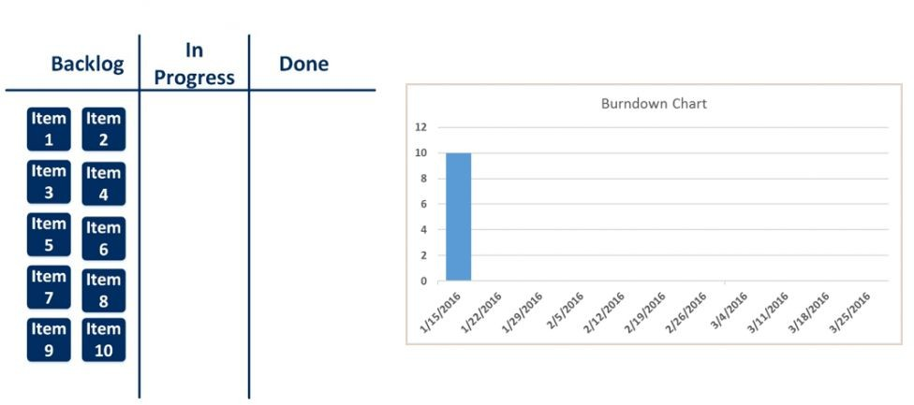
Perfect case: iteration 1

Slide 10
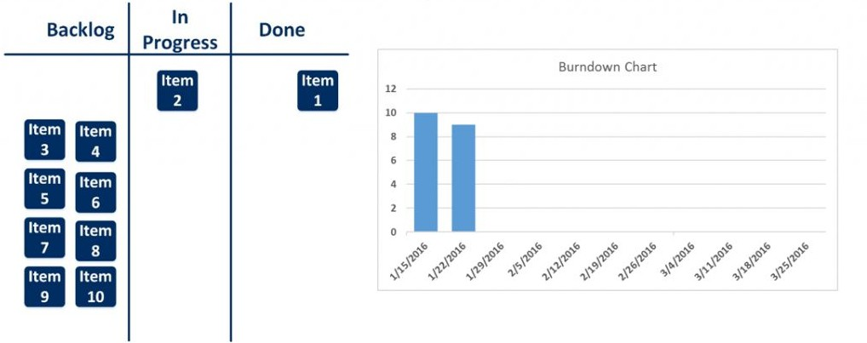
Perfect case: iteration 2

Slide 11
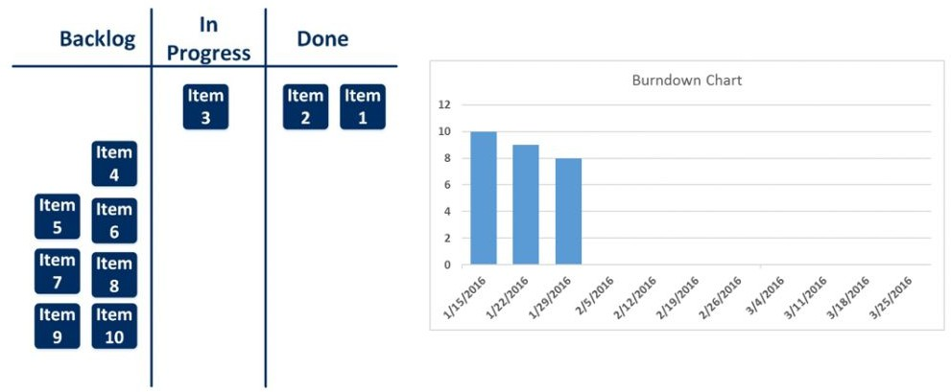
Perfect case: iteration 3

Slide 12
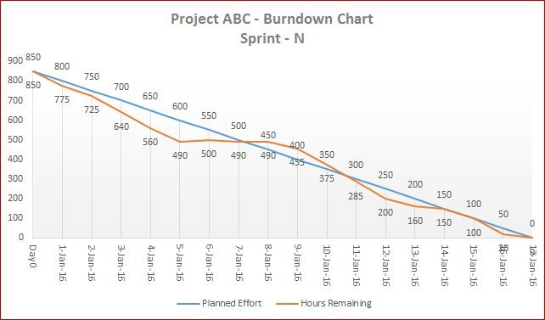
Burndown chart: example 1

Slide 13

Burndown chart: example 2

Slide 14
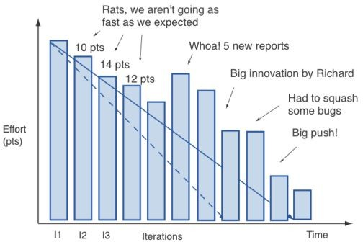
Effort may change over time

Slide 15
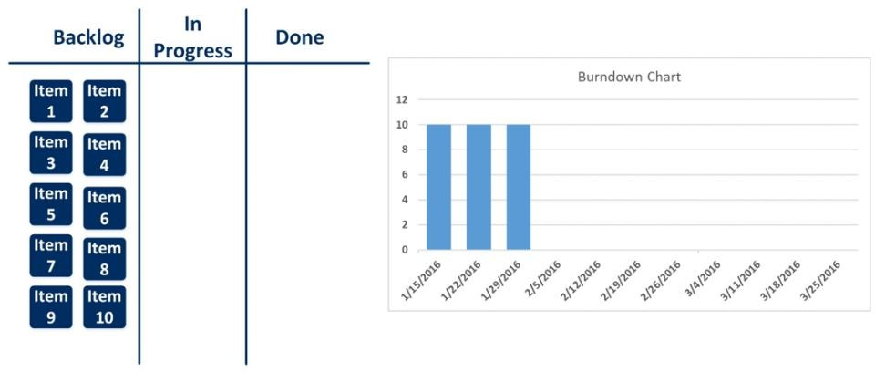
(Sad) reality: iteration 1

Slide 16
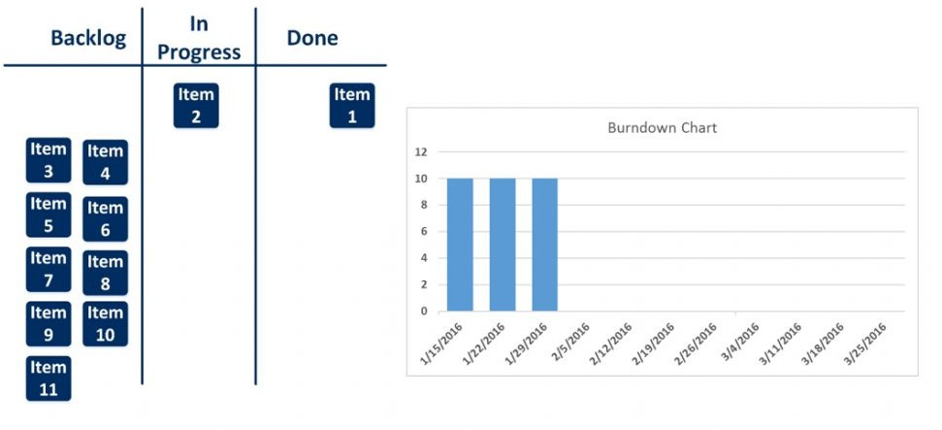
(Sad) reality: iteration 2

Slide 17
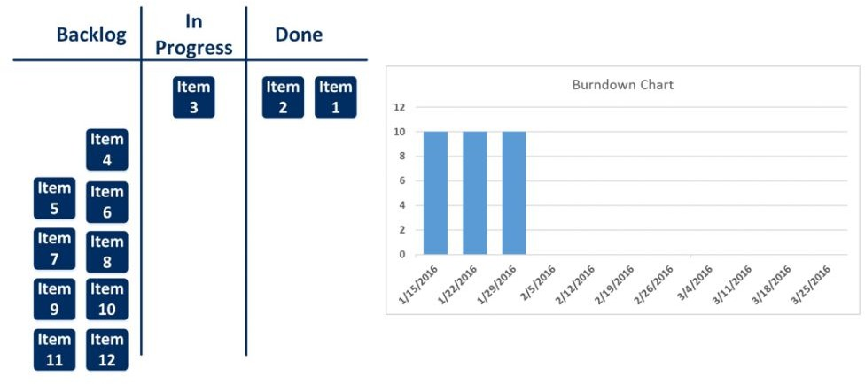
(Sad) reality: iteration 3

Slide 18
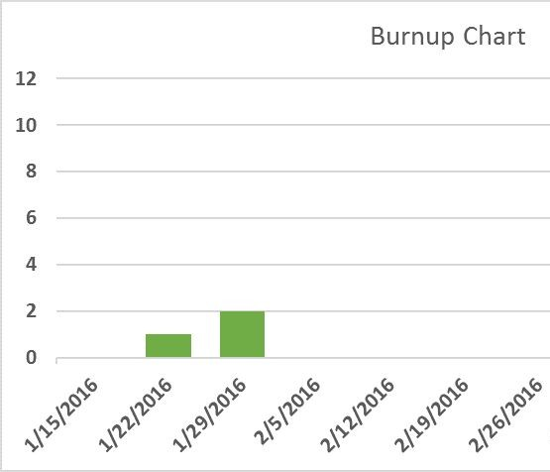
Burnup chart
Are there alternatives to the unedifying ‘flat’ burndown charts? The burnup charts.
Burnup charts answer the opposite question: how much work has been completed?
Whereas a Burndown chart should always tend downwards, an ideal Burnup Chart moves upwards
But why don't we like burnup charts?
They have no predictive utility
They do not push velocity up (I do not know how much effort is left to finish the job, so I do not 'speed up')

Slide 19
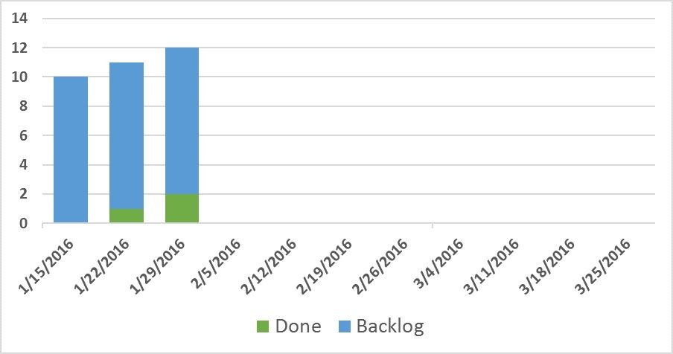
Cumulative Flow Diagram (CFD)
Advantages:
Exceeds the limits of Burndown and Burnup
Adds some extra data
Displays data in a better way
Promotes more robust decision-making processes

Slide 20
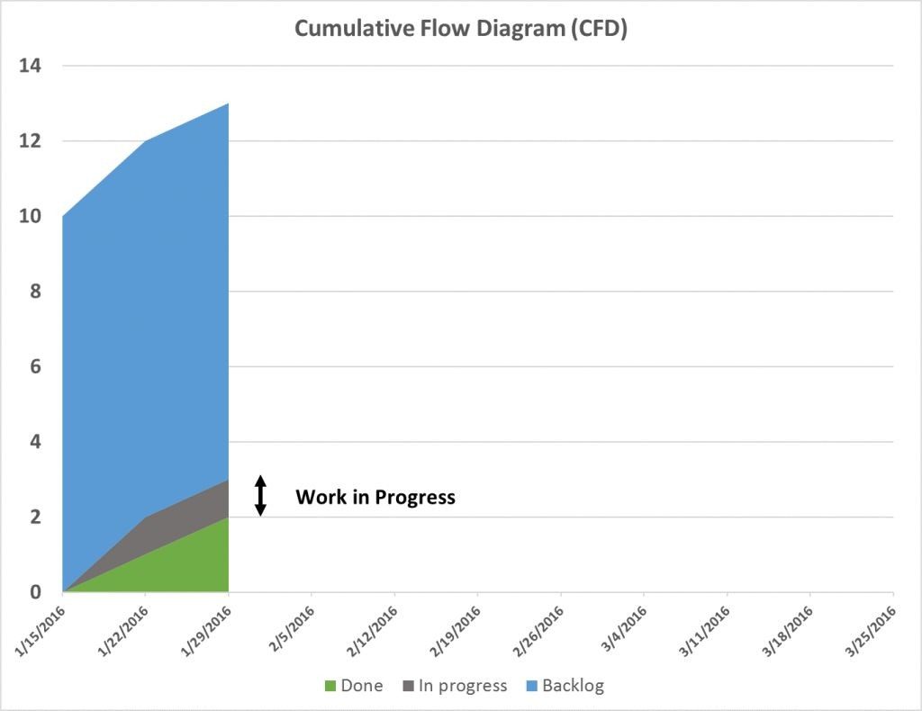
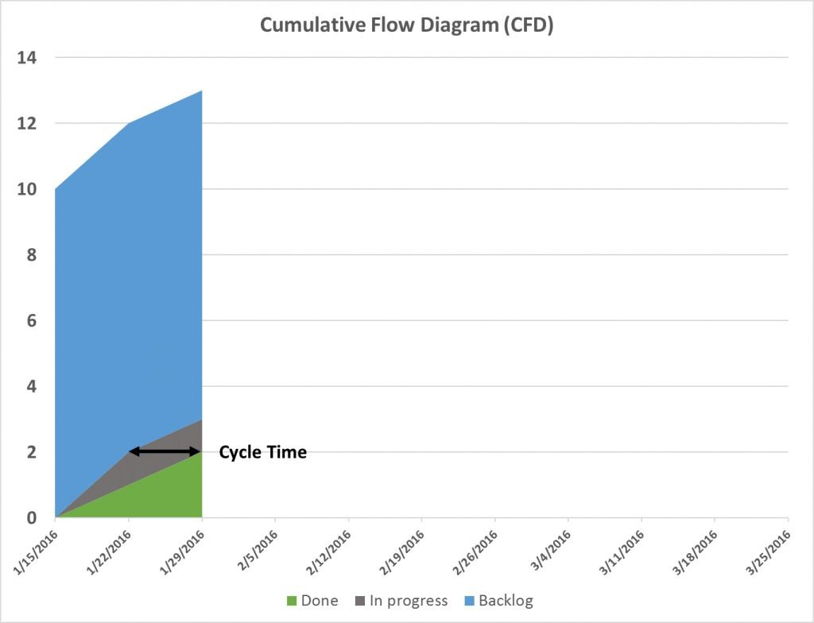
Cumulative Flow Diagram (CFD)

Slide 21
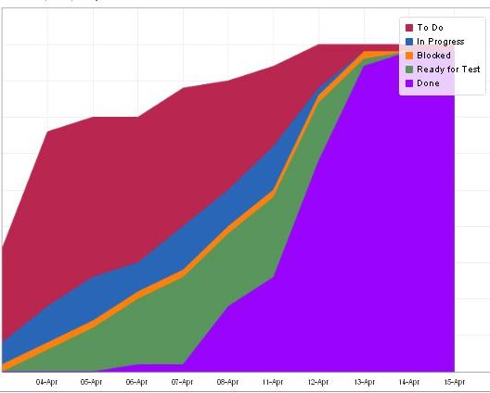
Cumulative Flow Diagram (CFD)
A CFD can have as many 'coloured bands' as there are states into which the process is divided (the columns of our board)

Slide 22
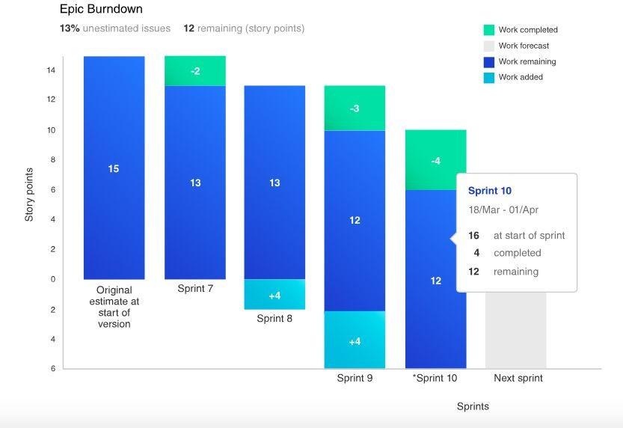
Epic and release burndown
Track project progress over different sprints, highlighting the ﬂow of work and any rework within an epic or version (even spread over several sprints)
Scope creep: adding new requirements to an already defined project

Slide 23
Epic and release burndown
Note: If scope creep between several epic is a problem during the sprint, it is a natural consequence of Agile development (the client can decide to accept or not accept the work done based on what emerges during the project)

Slide 24
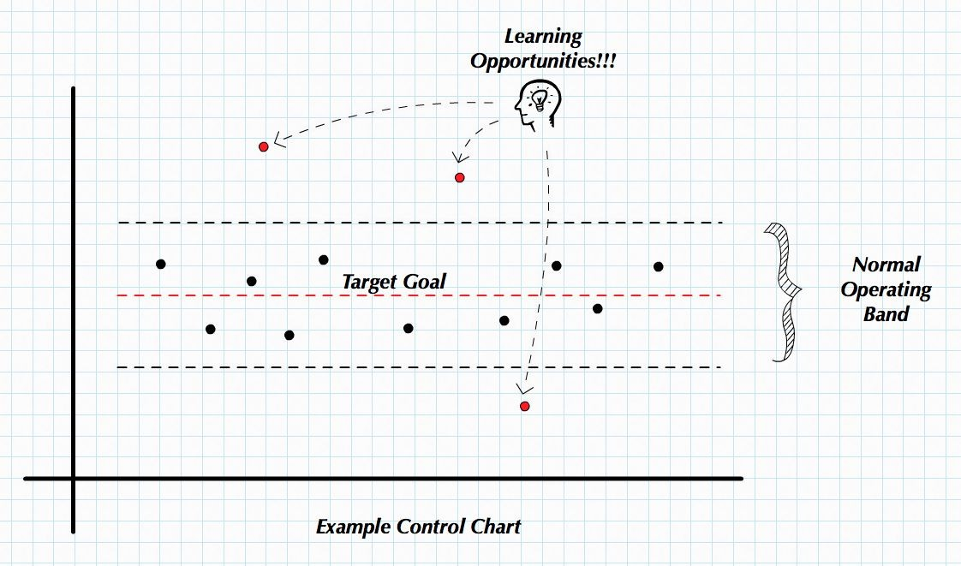
Control chart
It highlights the cycle time of the cards, i.e. the time between 'doing' and 'done'.
In an ideal situation, all cards/issues should be below the red line (average cycle time)

Slide 25
Control chart
In general:
Short cycle time → High productivity.
Constant cycle time → predictable delivery times.
The ideal situation is therefore to have teams with short cycle times and constant cycle times.

Slide 26
Other metrics
Quality
No. of reported defects (during the project, after release, from outside the team)
No. of customers submitting support requests
% coverage of tests carried out automatically
Frequency, Speed and Diﬃculty of releases

Slide 27
Other metrics
Metrics are only one step in the process of building a team culture.
They provide evidence of the team's performance and measurable objectives for its members but it is important to be able to collect feedback during retrospectives to increase the team's confidence, the quality of products/services and speed of execution of activities.
Both quantitative and qualitative data are needed to drive change!

Slide 28
4.2 How to avoid failure (2.5 hours)

Slide 29
How to avoid failure
Agile offers benefits ranging from more engaged employees to higher performance, but not so fast.
Why do Agile adoption projects often fail?

Slide 30
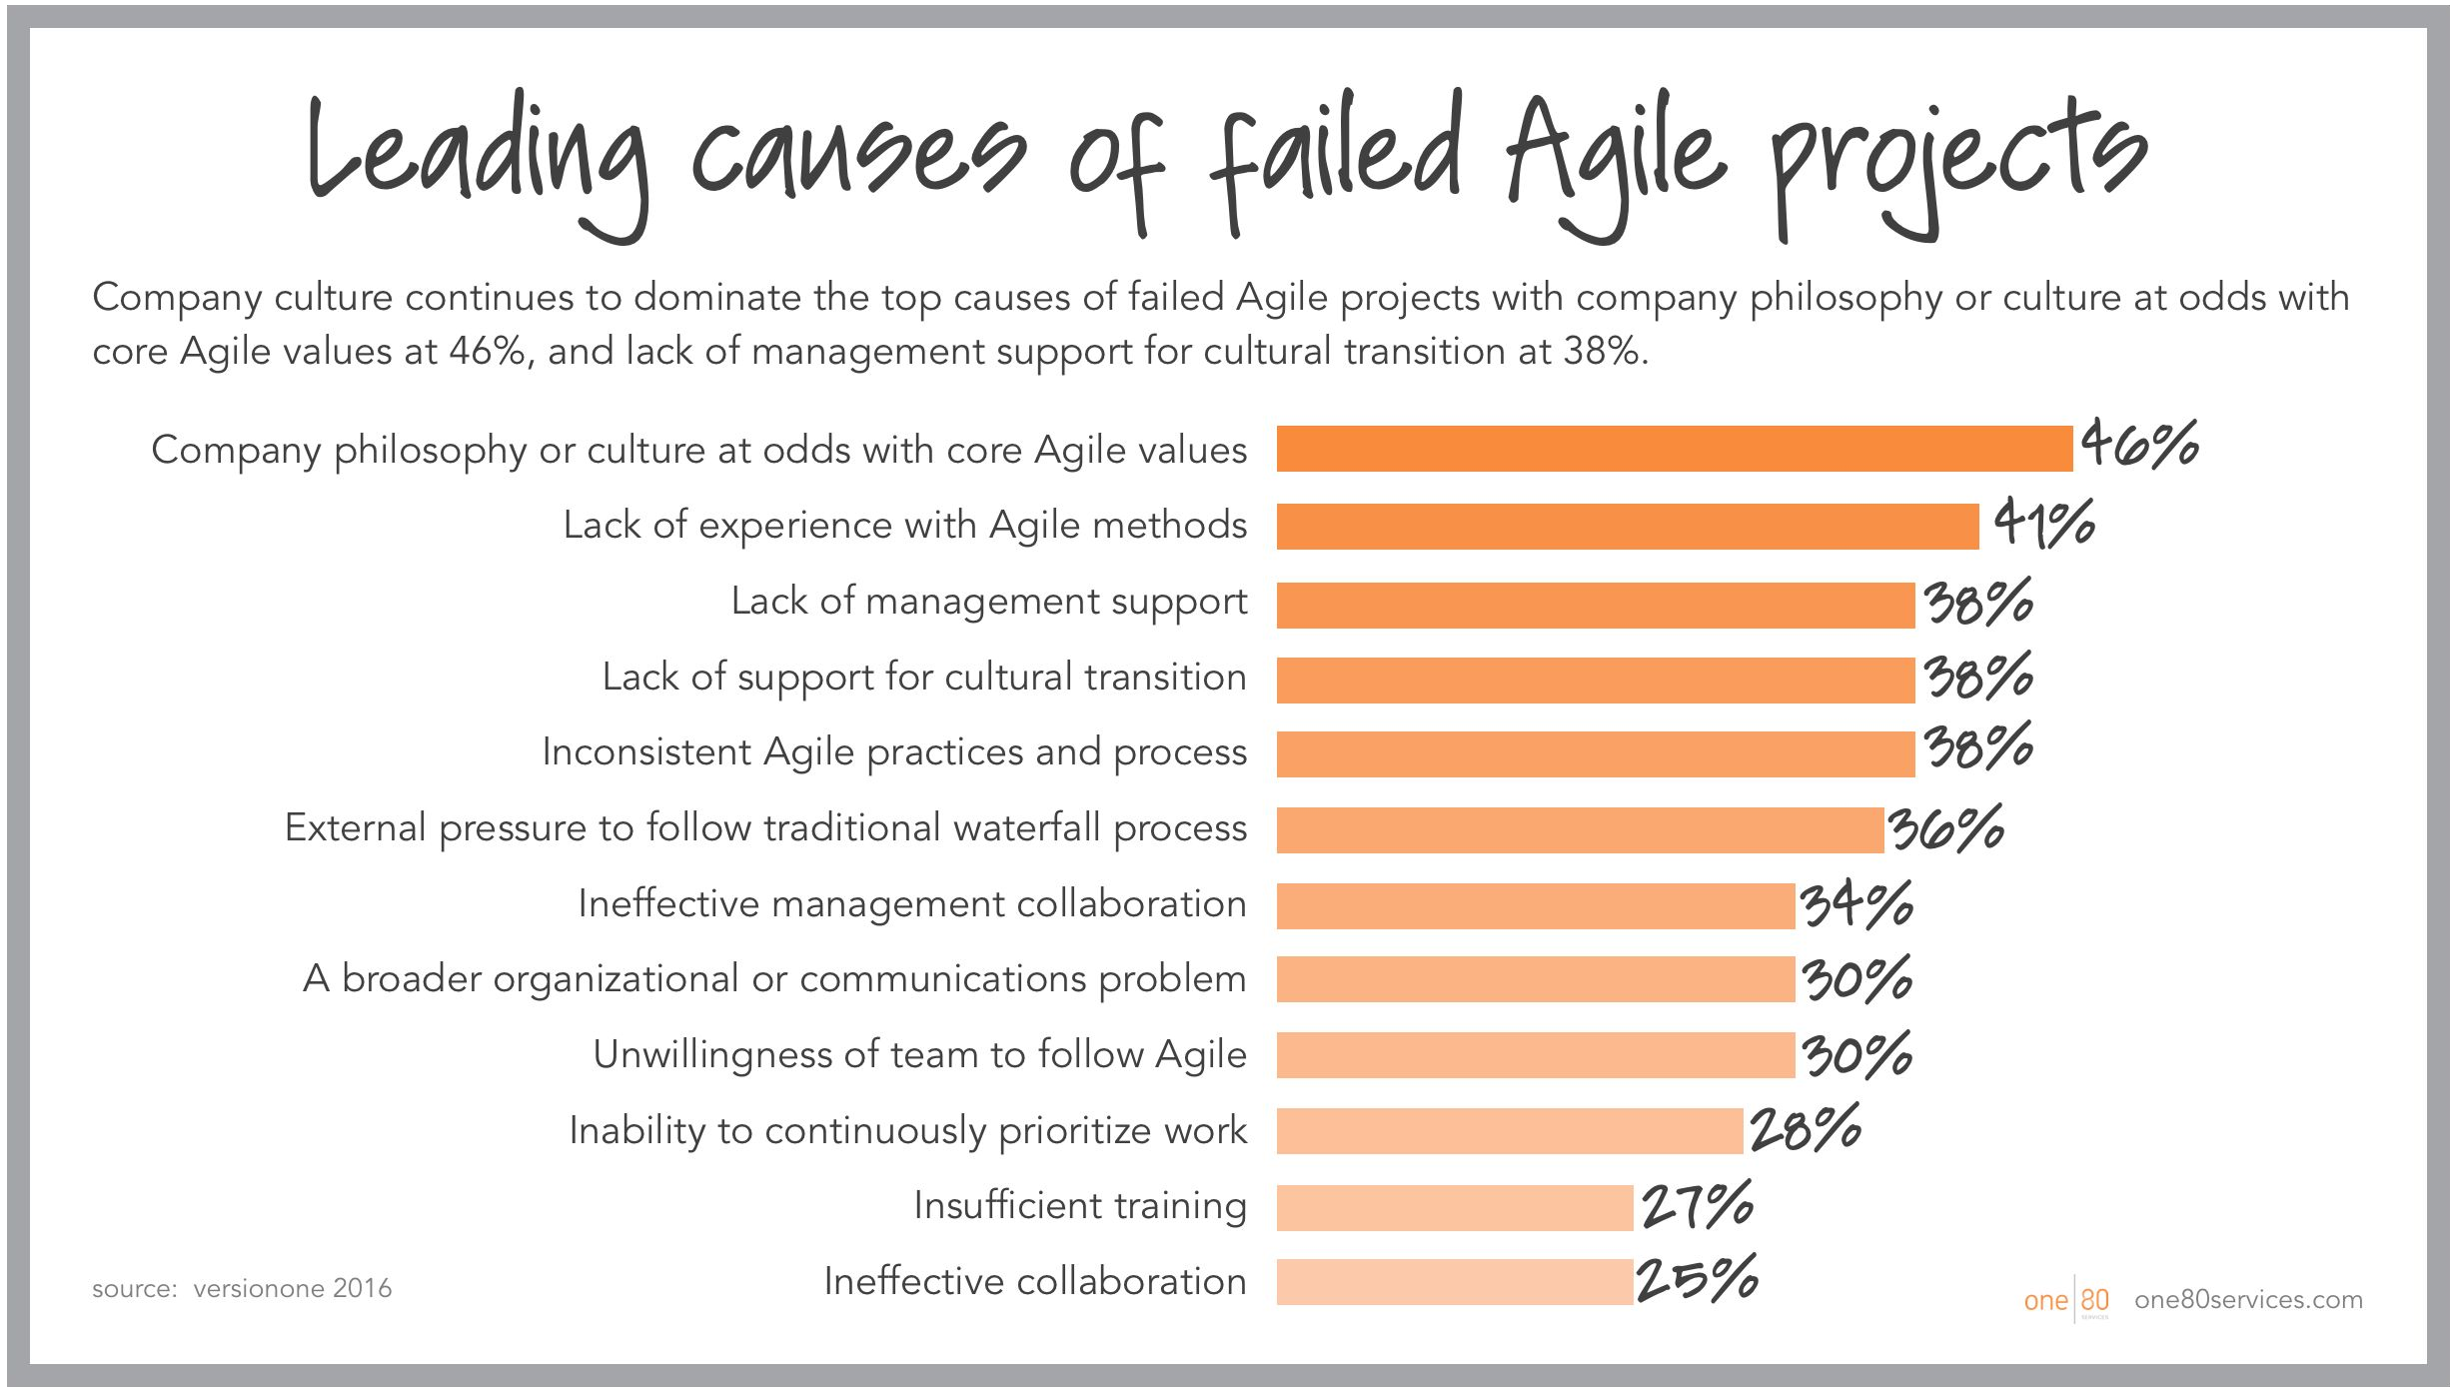
Typical causes of failure
A study conducted on more than 4,000 individuals highlighted the main causes of Agile failure.

Slide 31
Typical causes of failure
1. Contrasting organisational culture
Understanding that agile impacts organisational values and facilitating transformation is the first step towards wider adoption of agile
2. Lack of experience with the method
Investing in solid training in basic agile techniques and coaching for their correct application is money well spent

Slide 32
Typical causes of failure
3. Poor support in cultural transition
Tangible and active involvement of all management is crucial for cultural transformation
4. External pressure to Waterfall
Especially in large organisations, in order to facilitate coexistence between Agile and Waterfall teams, it is useful to involve people 'outside' Agile in meetings and to agree on mutual 'interfaces' for exchanging information

Slide 33
Typical causes of failure
5. Organisational and/or communicational issues
The effectiveness of Agile depends on a broad and deep acquisition of values and principles at organisational level
6. Team reluctance
Occurs when team members fear losing identity or control
7. Insufficient training
Ensure that all those involved (including leaders) receive solid training on Agile

Slide 34
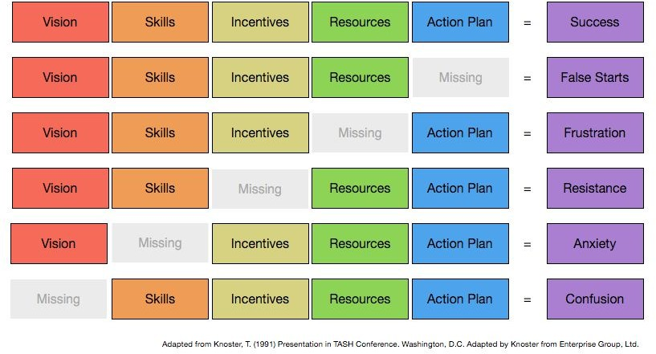
A model for change management

Slide 35
Agile adoption vs Agile transformation
Agile adoption: use of tools and techniques in line with Agile principles.
Agile transformation: process of evolution of the culture and nature of the organisation.

Slide 36
Agile adoption vs Agile transformation
 | ADOPTION | TRANSFORMATION
Answers the question | What do we do? | Who are we?
Emphasis on | Practices | Values and principles
Speed of change | Fast | Slow
Time horizon | Short period | Long Period
Impact on results (productivity) | 100% | 300%
Changes in organisational structure | Few or none | Significant
Changes in organisational culture | At most localised | Broad-spectrum

Slide 37
4.3 Reconciling Waterfall and Agile (2.5 hours)

Slide 38
Creating the Gantt from cards
Regardless of the approach taken, we are often asked to produce a project Gantt. With respect to Agile, we can try to do this by starting with the very cards on the board.

Slide 39
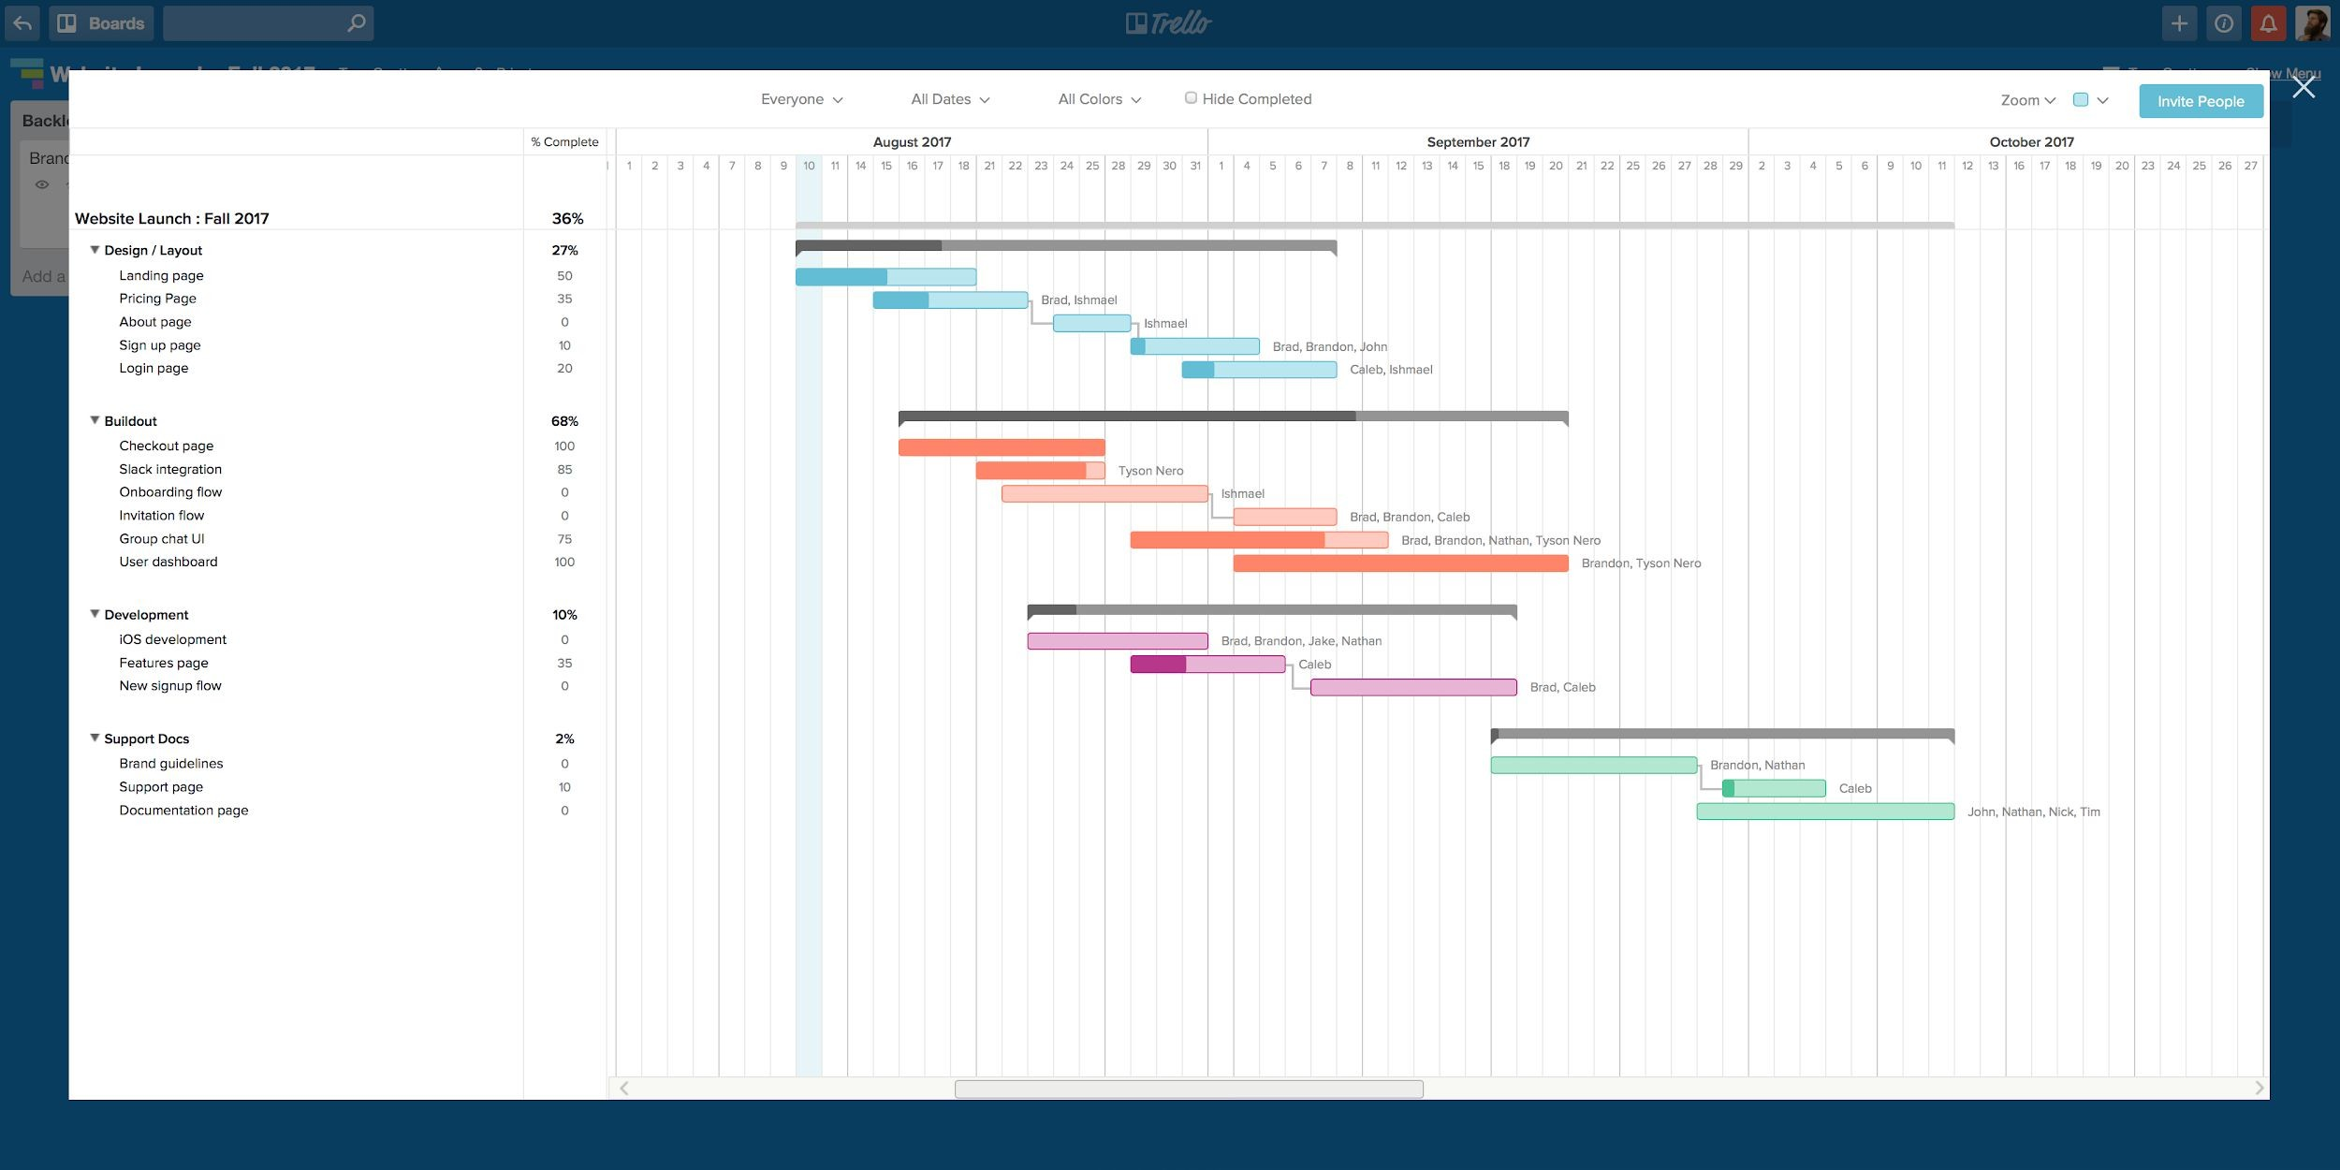
A digital tool: TeamGantt

Slide 40
A digital tool: TeamGantt
TeamGantt is a digital tool that allows you to:
create, share, update Gantt
reorganise tasks
display all projects in one view
manage resources, control budget and make sure to avoid overload
create reports
check progress against plan and make projections
list tasks and schedule them
track activities

Slide 41
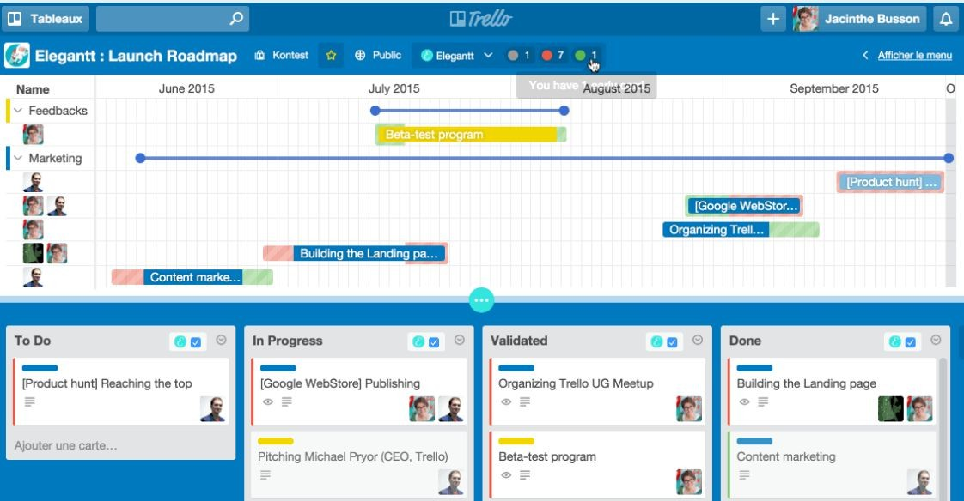
A digital tool: EleGantt

Slide 42
A digital tool: EleGantt
EleGantt is a digital tool that allows you to:
display the Gantt directly in each board starting from the cards present
automatically update the Gantt based on changes to cards, lists, assignees
display dependencies between cards
display deadlines and send automatic reminders to the team
group, filter or reorder cards

Slide 43
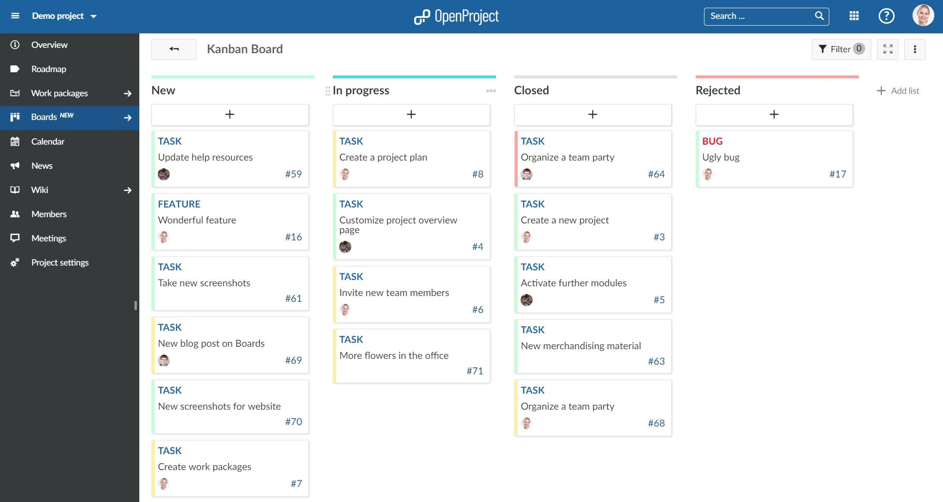
A digital tool: OpenProject

Slide 44
A digital tool: OpenProject
OpenProject is a project management digital tool that allows you to:
create product and sprint backlogs
estimate activities in story points
use card templates
create burndown charts
track 'impediments' for sprints
assign and prioritise activities
display activities on calendar or board

Slide 45
Monitor overall progress
How to monitor the progress of activities?
Define Sprint Goals (max 3 or 5) and ask the PM to indicate the % achievement of each one.
Sprint Goals: sub-goals corresponding to sets of cards (≈ Epic)

Slide 46
Monitor progress with sprint goals
Use Agile as a tool for the micro-management of the team (also in waterfall projects):
Organise team work by weekly sprints and hold regular meetings (1 planning and 1 retrospective)!
Keep the team's velocity under control
Use goals as milestones and evaluate overall progress by % of their completion

Slide 47
Scrum of scrum
How to apply Agile to projects involving many people?
Scrum of scrum (general meaning): technique for applying Agile to large organisations.
Scrum of scrum (specific meaning): meeting held regularly between the MS of each team to share information.

Slide 48
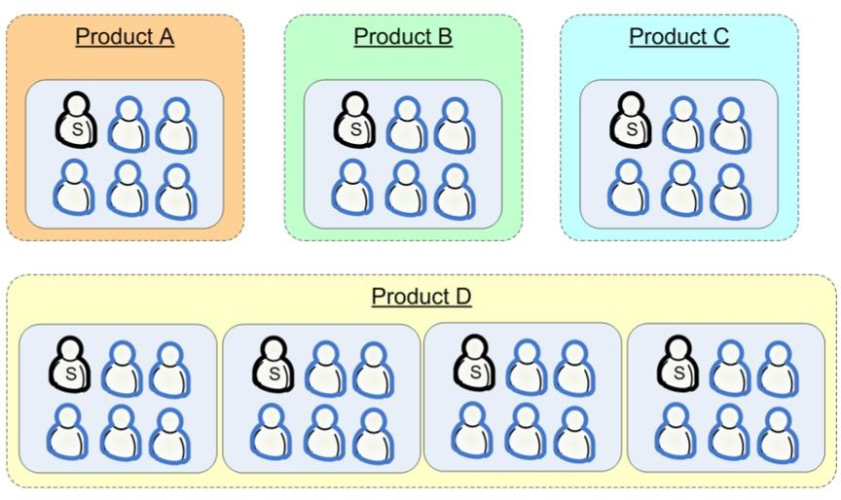
Scrum of scrum
Two levels different:
1. 'Corporate scrum of scrum' (all MS of all products)

Slide 49
Scrum of scrum
2. 'Product scrum' (all MS of product 'D')

Slide 50
Scrum of scrum
Product/project scrum: 30-minute meeting, once a week where:
Each MS describes what the team did last week, what it will do in the current week and what obstacles it foresees
MS share issues that affect all teams (e.g. related to integration)

Slide 51
Product/project scrum
30-minute meeting, once a week where:
Each MS describes what the team did last week, what it will do in the current week and what obstacles it foresees
MS share issues that affect all teams (e.g. related to integration)

Slide 52
Corporate scrum
15-30 minute plenary meeting, perhaps once a week where:
All team members receive news from the management (e.g. about upcoming events of a general nature)
"Round-robin': in turn, one member reports what their team did last week, what they will do in the present week, and what problems they foresee
Anyone else is free to add information or ask questions
Note: Intersperse the meetings, allowing those who must to participate in more than one meeting

Slide 53
Multiple Scrums
What happens when several teams work on the same project?
In general, the rule applies: more members = more complications.
That is why it is essential to understand
how many teams to use
how to allocate people between teams

Slide 54
Multiple Scrums
As a rule, it is preferable not to have teams larger than 9 persons in order to avoid:
Long meeting (>15 min)
People who don’t know what others do
Distractions
Tight deadlines to resolve unforeseen issues

Slide 55
Multiple Scrums
Is it enough to split up the larger teams?
The idea of splitting the team can only be effective if:
The team has experience with Agile
The roadmap can be subdivided (without compromising the output)
Beware of virtual teams! By observing whether and how members interact, one can see the existence of 'virtual teams'.

Slide 56
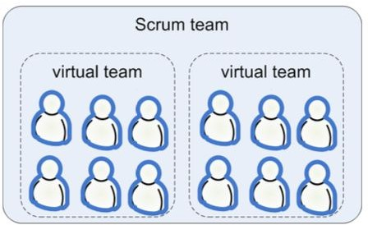
Virtual teams: case 1
You opt for one big team, but observing who talks to whom during the sprint, you notice a division into 2 sub-teams

Slide 57
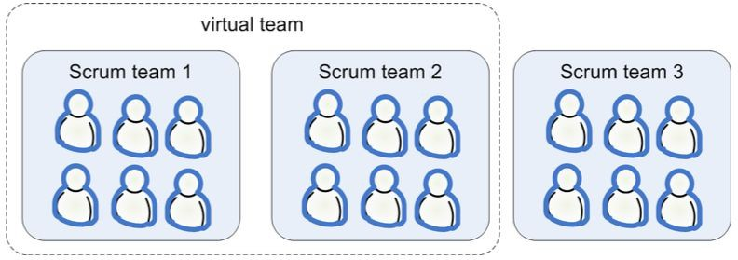
Virtual teams: case 2
Three smaller teams are used, noting however that while the first and second interact frequently, the third remains isolated
Does this mean that the team size is wrong? whether virtual teams are permanent
Yes, if they are permanent
No, if they are temporary

Slide 58
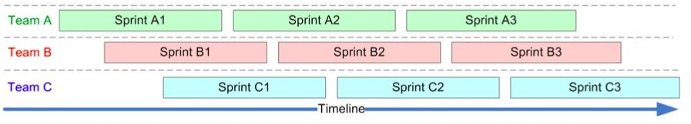
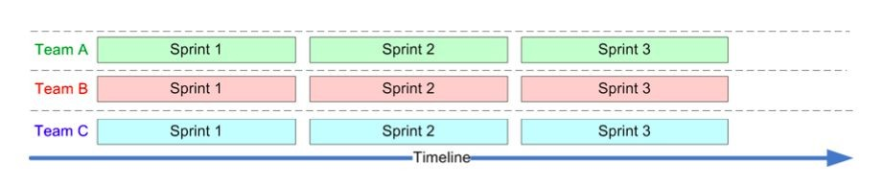
Multiple Scrums
What to do instead if several teams are working on the same project?
1. Synchronising Sprints
Advantages:
Shared meetings
A single moment to redefine teams (between sprints)
Fewer administrative tasks

Slide 59
Multiple Scrums
2. Appoint a Team Lead (Scrum Master of all teams)
The Team Lead decides on the composition of the teams and their changes between several sprints.
Note: before any change to the team, do not underestimate the so-called 'team gel' (bonds created by working in a team)
What about part-time members? In general, a few full-time people are better than a larger team of part-time members

Slide 60
Multiple Scrums
How to maintain the balance between planned and emerging activities?
One solution is to create 2 types of teams:
Scrum Team
Fire Team
Scrum Team: under the guidance of the PM carries out activities trying to prevent emergencies.
Fire Team: support team dedicated to resolving emergencies and protecting against other disruptive elements

Slide 61
Multiple Scrums
How to manage geographically distributed teams?
If the effectiveness of Agile depends a lot on the intensive and direct collaboration of the team it is necessary that this can also be done remotely, enabling members to:
working at the same time
participate in daily meetings
have direct, spontaneous and immediate contacts
have visibility of the board, the backlog and access to all useful information (e.g. diagrams)

Slide 62
Multiple Scrums
How to do it?
Conference room with workstation(s) equipped with connection, webcam, microphone, collaboration software
Remote windows: screens placed in each location showing other members and/or project progress data
If possible, it is preferable to have one dispersed team rather than several 'co-located' teams

Slide 63
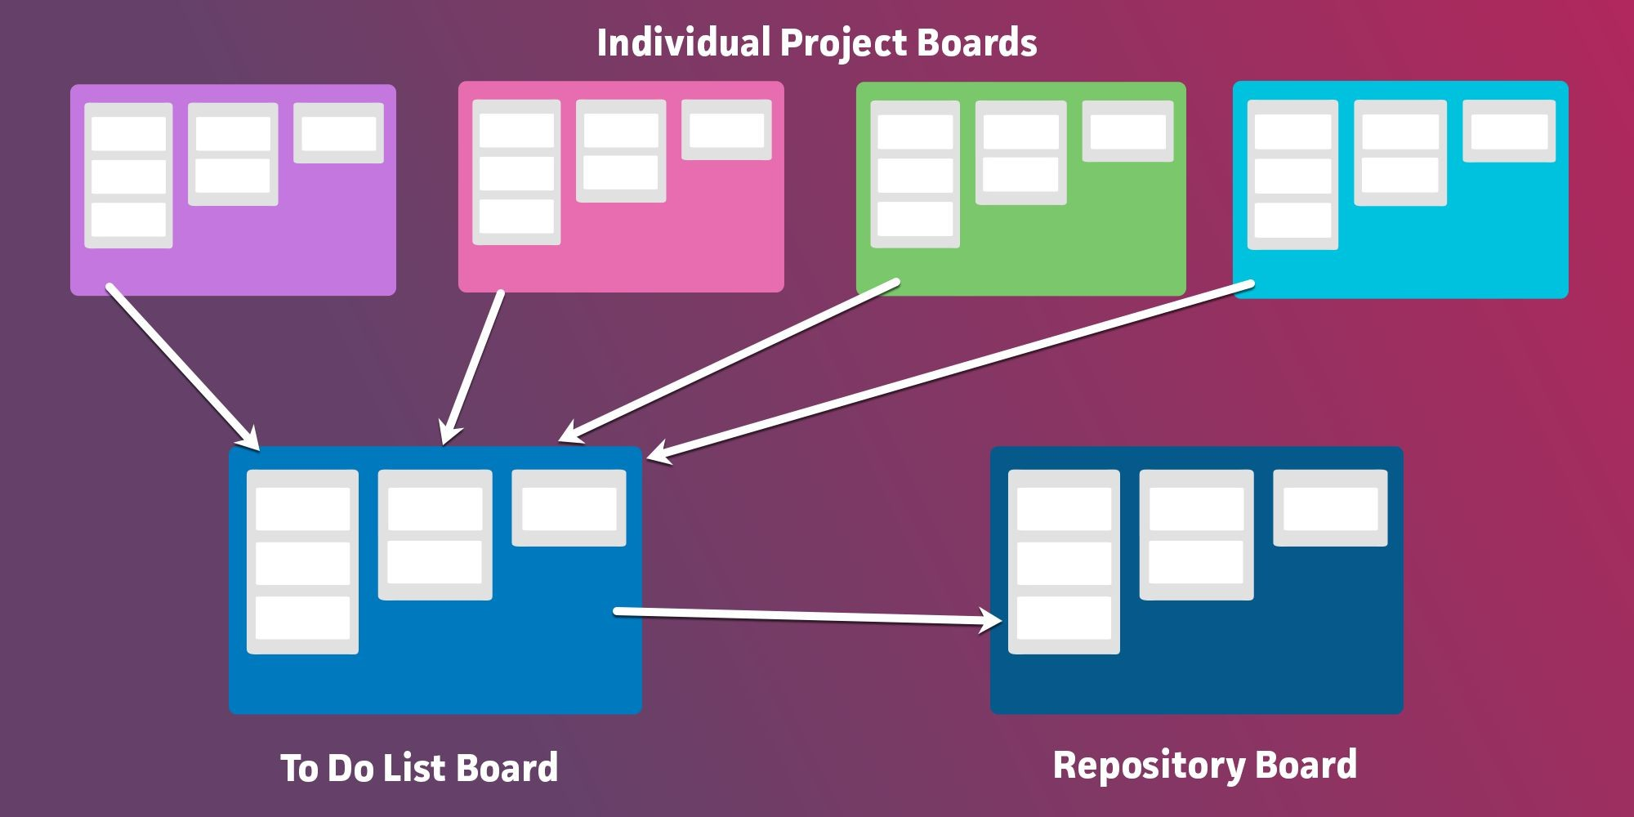
Multiple Scrums
Which tools should be used to manage multiple Scrums?

Slide 64
Multiple Scrums
Which tools should be used to manage multiple Scrums?
Create a 'To Do List' board where, at each sprint, you move (or copy) cards from your personal boards
Create a 'board repository' to store project materials, resources (and cards) common to all members
If useful, create automatisms for recurring card movements (e.g. with Zapier or Butler)

Slide 65
Scrum master checklist
At the beginning of each Sprint:
After Sprint planning, create a Sprint information document (estimated speed, team size, duration, etc.), print it out and hang it on the team's most prominent wall.
Send an e-mail to all stakeholders announcing that the new sprint has started (include the objective of the sprint and a link to the information document).
Update the information document with the sprint statistics.

Slide 66
Scrum master checklist
Every day:
Ensure that the Daily Scrum is started and finished on time.
Ensure that cards are added/removed from the backlog only when necessary and that the PM is informed.
Ensure that the sprint backlog and burndown are kept up to date by the team.
Ensure that problems are resolved or reported to the PM.

Slide 67
Scrum master checklist
At the end of each Sprint:
Make a demo of the Sprint open to everyone and announcing it 1-2 days in advance.
Do a retrospective of the Sprint with the whole team and the PM.
Update the Sprint statistics document. Add the actual speed and key points from the retrospective.

